Slide 1
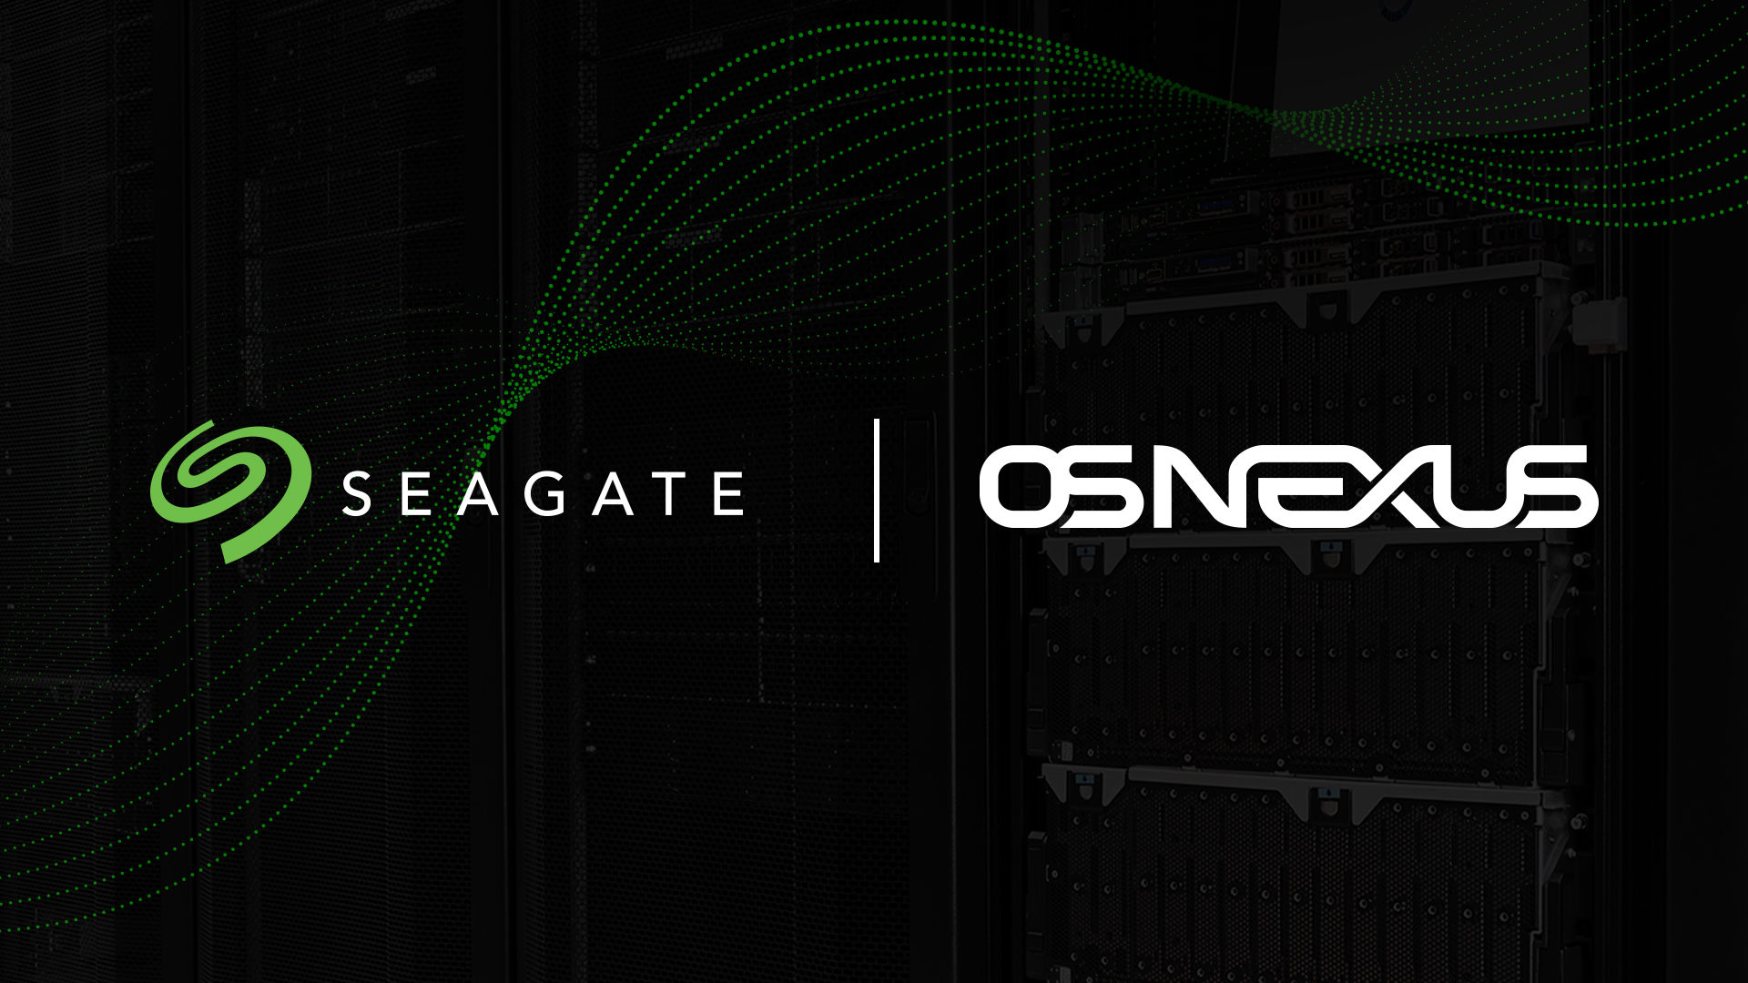
Capturing Next Gen Storage Efficiencies

Slide 2


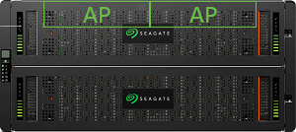
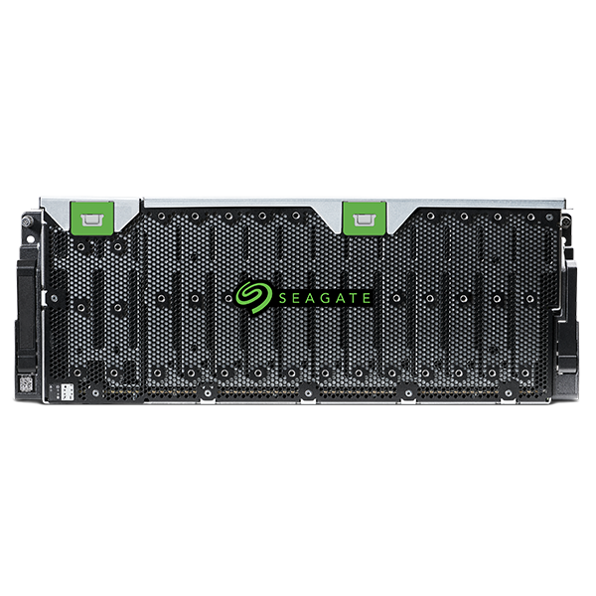
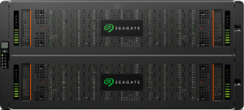

Next Generation Software Defined Storage
Storage Grid Technology
Grid technology unifies management of QuantaStor systems across racks, sites, and clouds.
Security
Advanced RBAC, end-to-end encryption support, and compliance with NIST 800-53, 800-171, HIPAA, CJIS, & FIPS 140-2 L1 certified.
Unified File, Block & Object
All major storage protocols are supported including NFS/SMB, iSCSI/FC/NVMeoF, and S3.
QuantaStor 6
Software Defined Storage Platform
Hardware Integrated
QuantaStor is integrated with the entire line of Seagate AP, Seagate CORVAULT, and Seagate Exos JBODs & JBOFs.
Scale-up & Scale-out
Integrated with enterprise-grade open storage technologies (Ceph & ZFS).

Slide 3





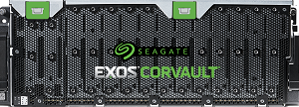
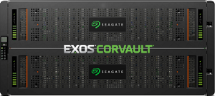
Flexible Storage Solutions
Seagate+QuantaStor
Scale-up
File & Block
Storage Clusters
Seagate+QuantaStor
Scale-out
Object, File & Block Storage Clusters
Seagate
AP Systems
Auto Tiering
Seagate JBODs
Seagate CORVAULT
QuantaStor Storage Grid

Slide 4

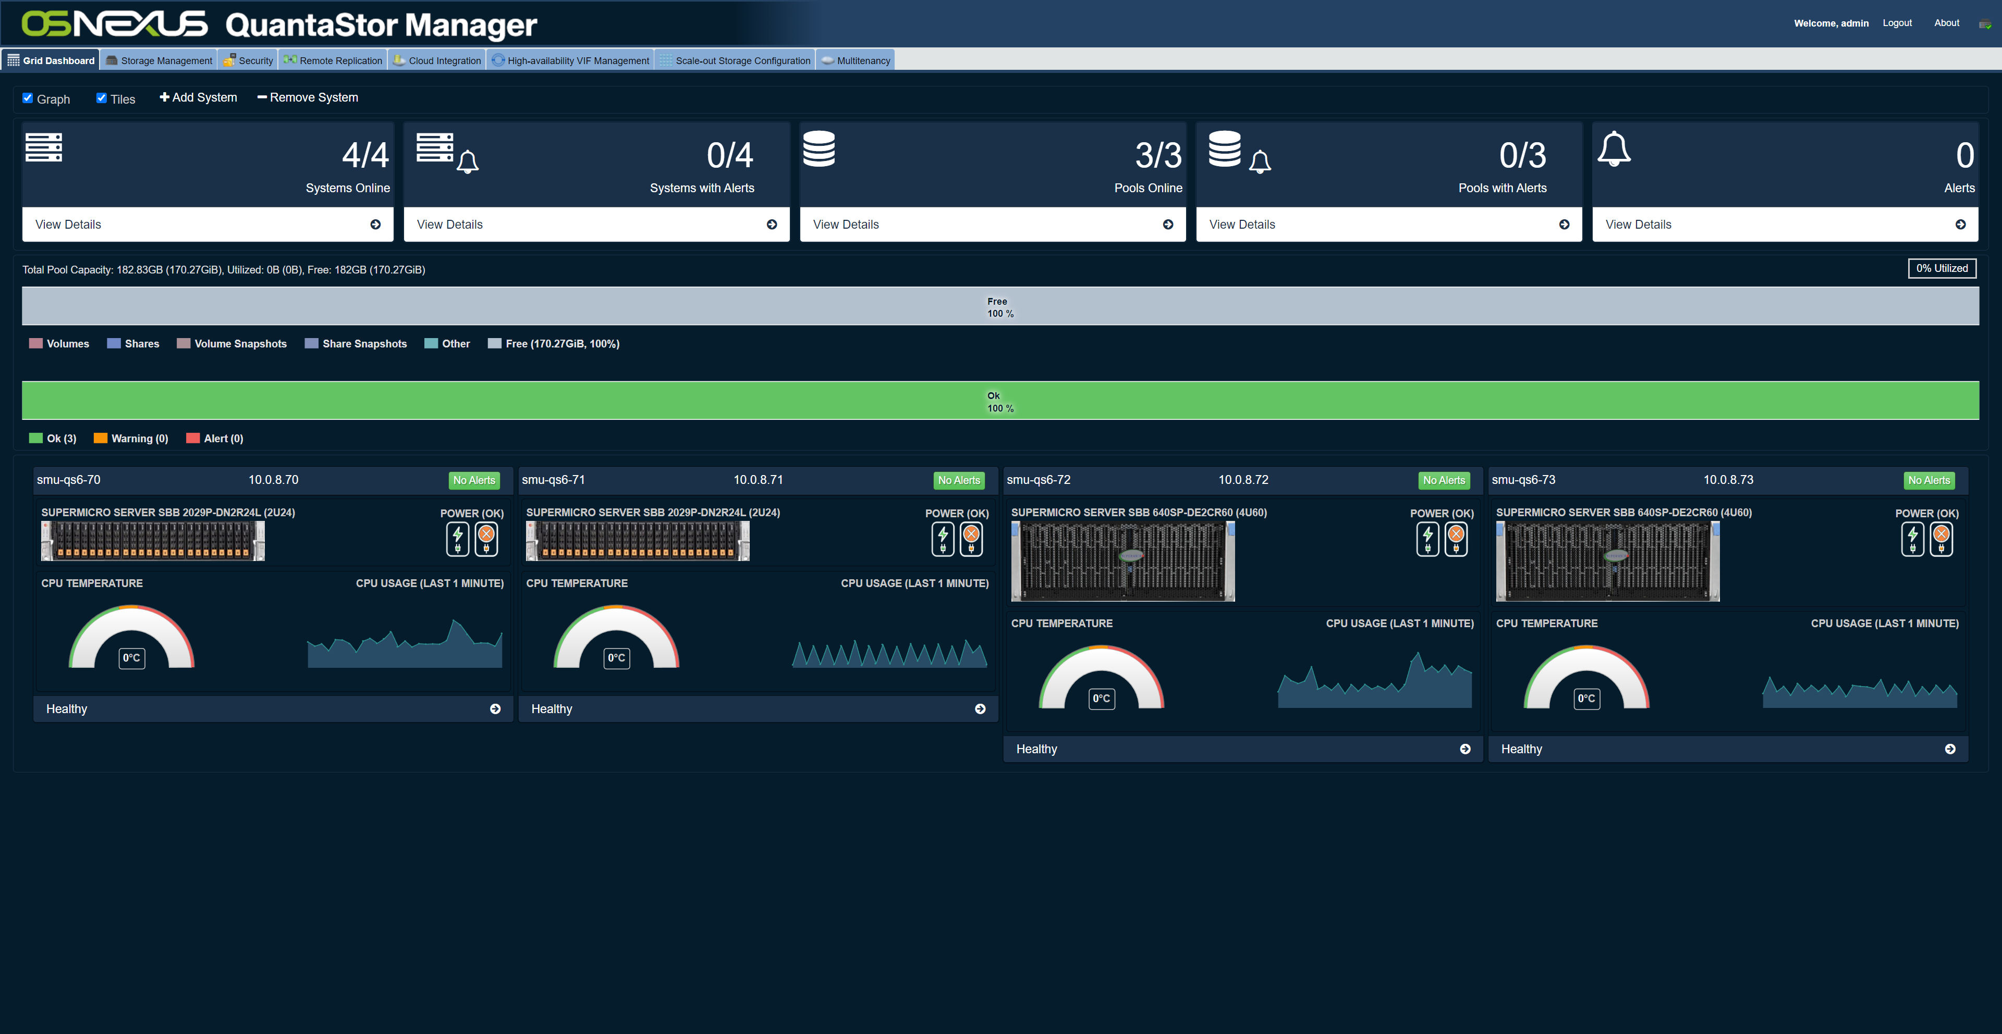
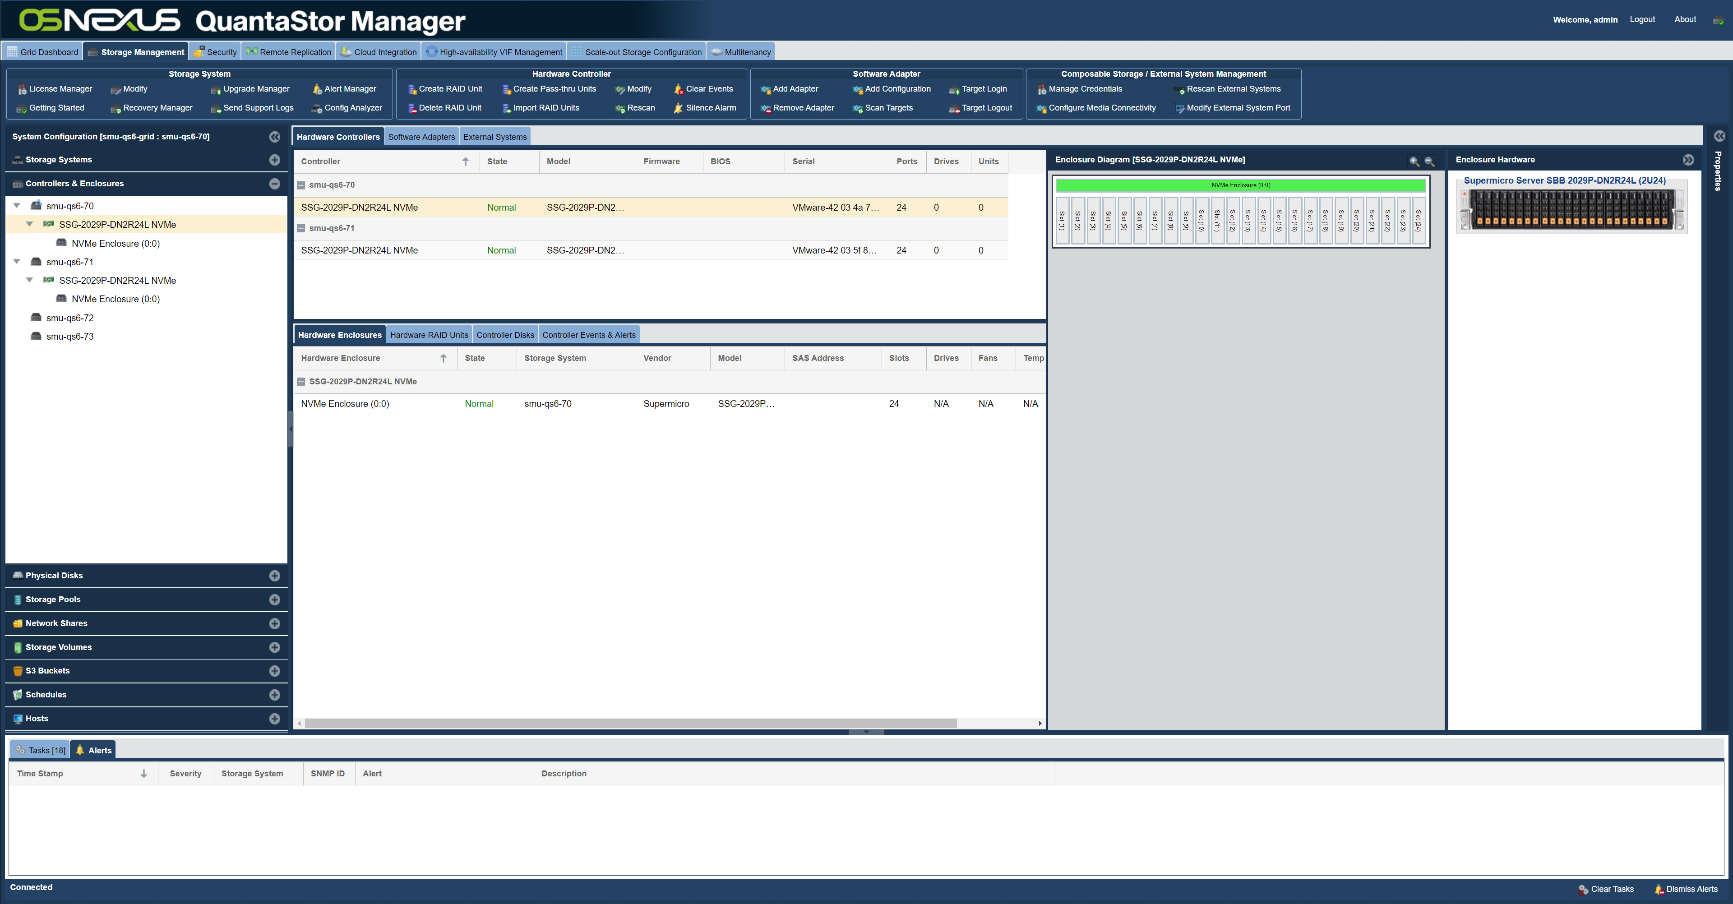
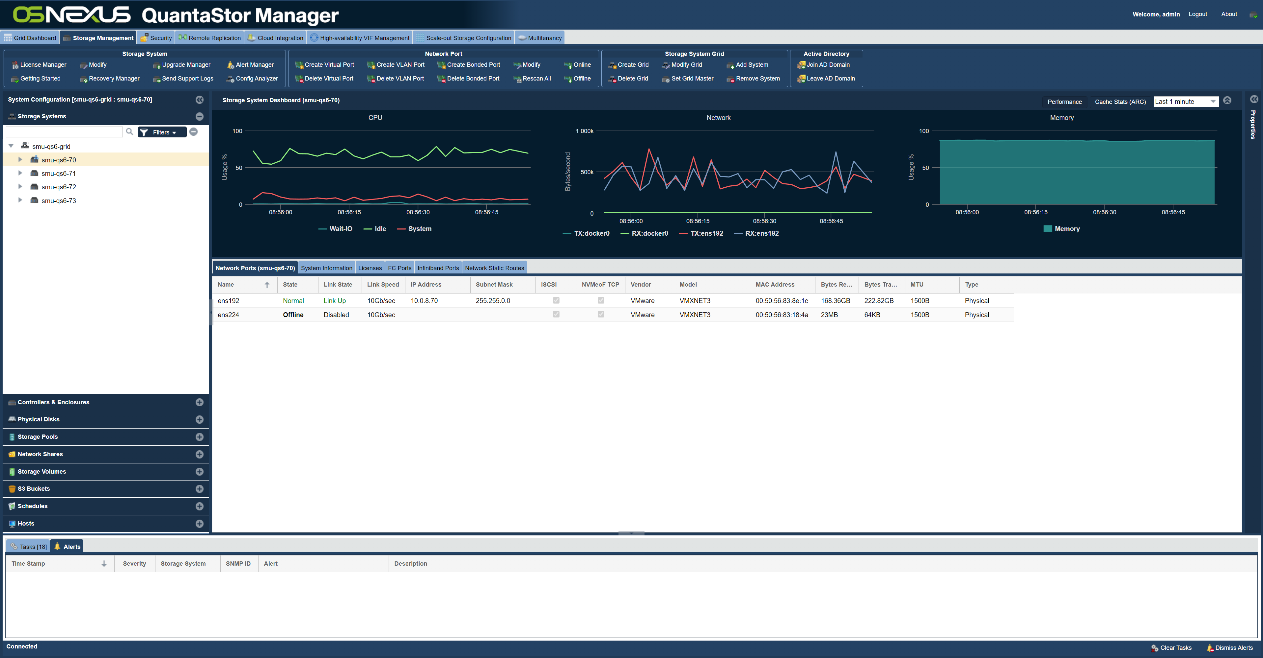
QuantaStor systems have a built-in distributed control plane referred to as the “storage grid”.
All systems within a storage grid provide web management, API, and CLI access simultaneously.
No additional software to install or maintain.
Unified Storage Management

Slide 5
Unified Multi-site Management & Security Enforcement
Los Angeles
New York
Montreal
Phoenix
S3/SAN/NAS
S3/SAN/NAS
SAN/NAS
SAN/NAS
SAN/NAS
SAN/NAS
SAN/NAS
QuantaStor Storage Grid

Slide 6
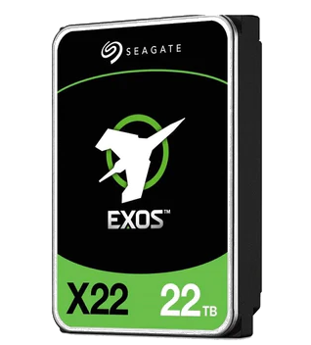
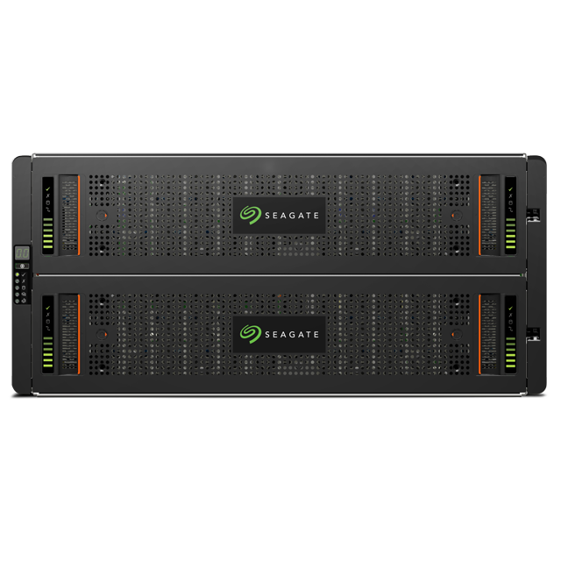

Seagate Corvault vs Seagate Exos E
Disk Group 1
ADAPT 16+2
Erasure Coding
Logical Volumes
Seagate Corvault 5U84 systems deliver fault tolerant Logical Volumes to systems via SAS but with fast auto-healing technology.
VOLUME
VOLUME
VOLUME
VOLUME
VOLUME
VOLUME
VOLUME
VOLUME
VOLUME
VOLUME
VOLUME
VOLUME
VOLUME
VOLUME
VOLUME
VOLUME
VOLUME
VOLUME
SAS
SAS
SAS
Disk Group 2
ADAPT 16+2
Erasure Coding
VOLUME
VOLUME
VOLUME
VOLUME
VOLUME
VOLUME
SAS
Seagate Exos E 5U84 JBODs deliver media direct to systems via SAS but don’t bring the huge benefits of ADR & ADAPT.
VOLUME
VOLUME
VOLUME
VOLUME
VOLUME
VOLUME
VOLUME
VOLUME
VOLUME
VOLUME
VOLUME
VOLUME

Slide 7
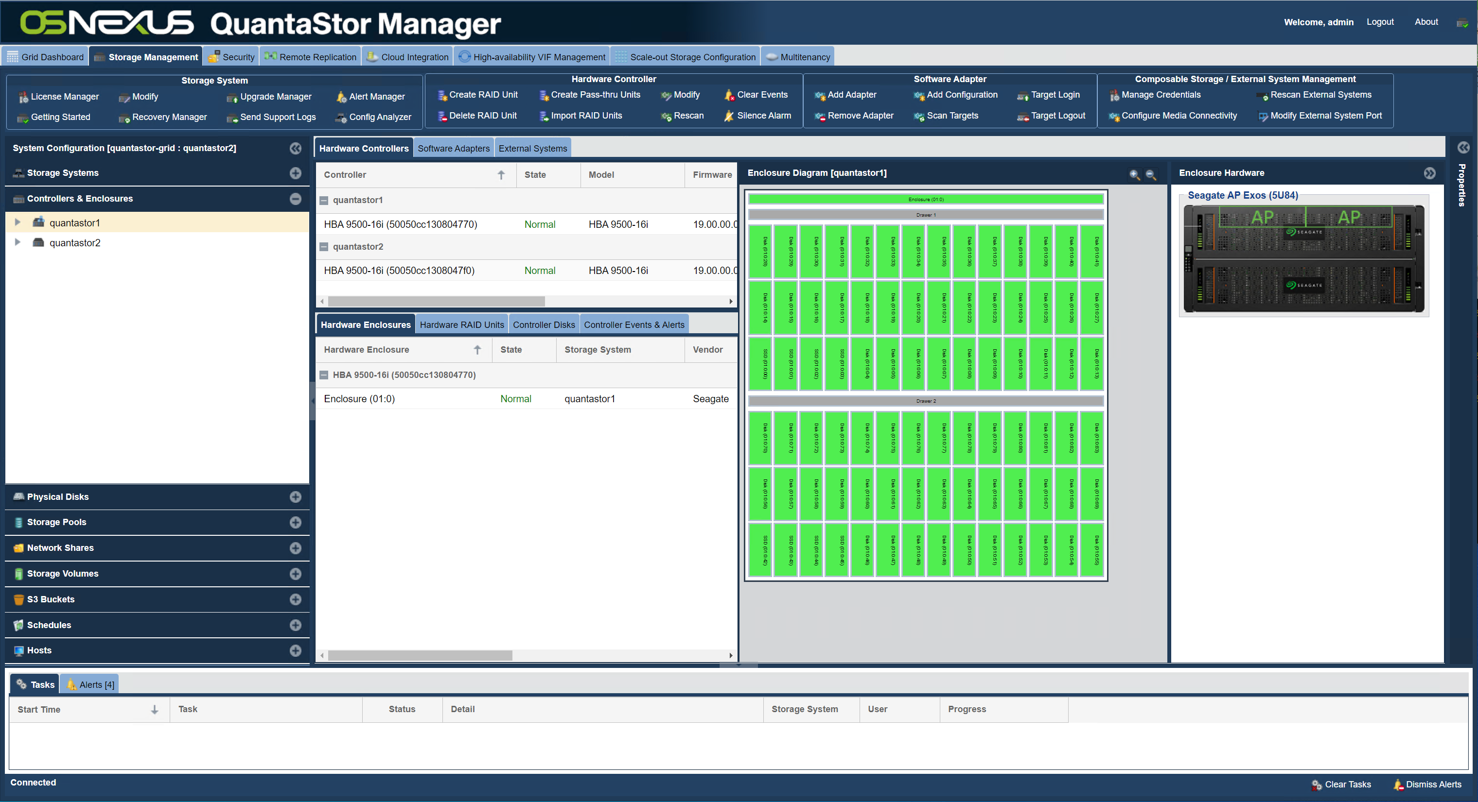
Seagate Integrated

Slide 8
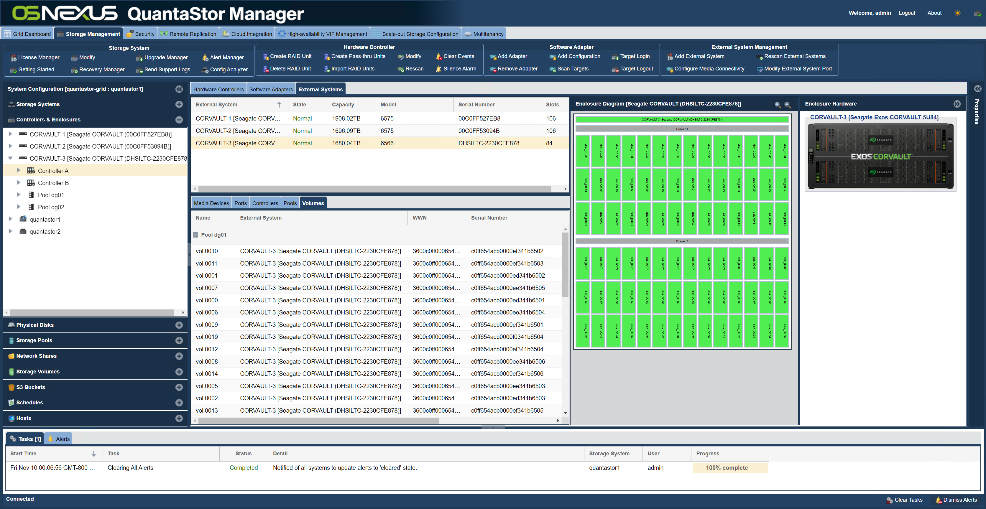
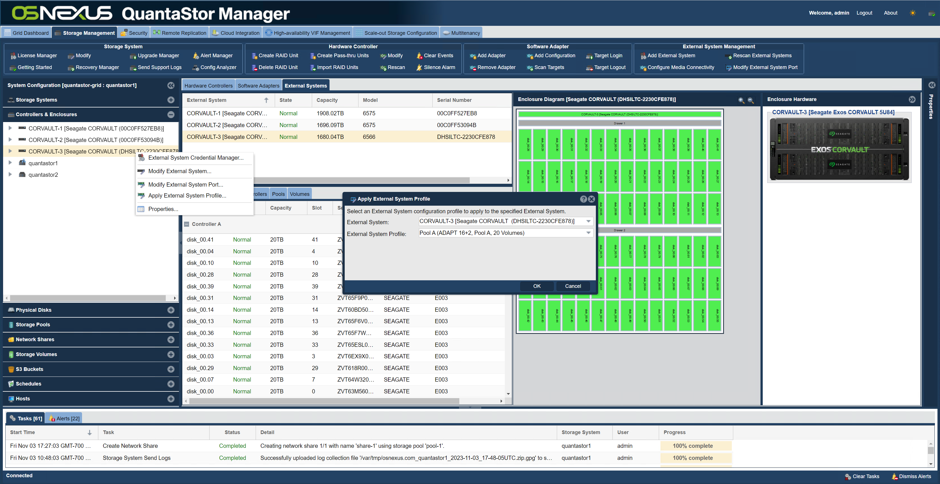
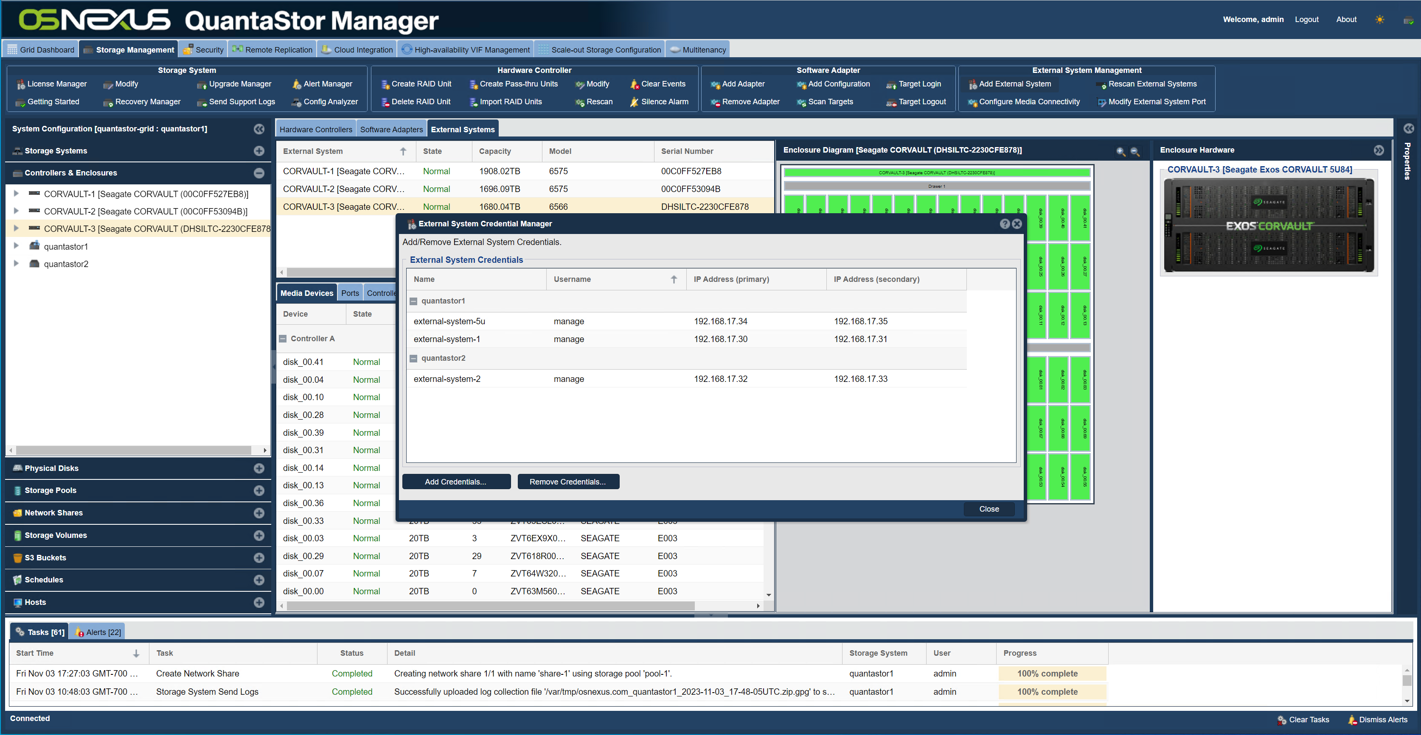
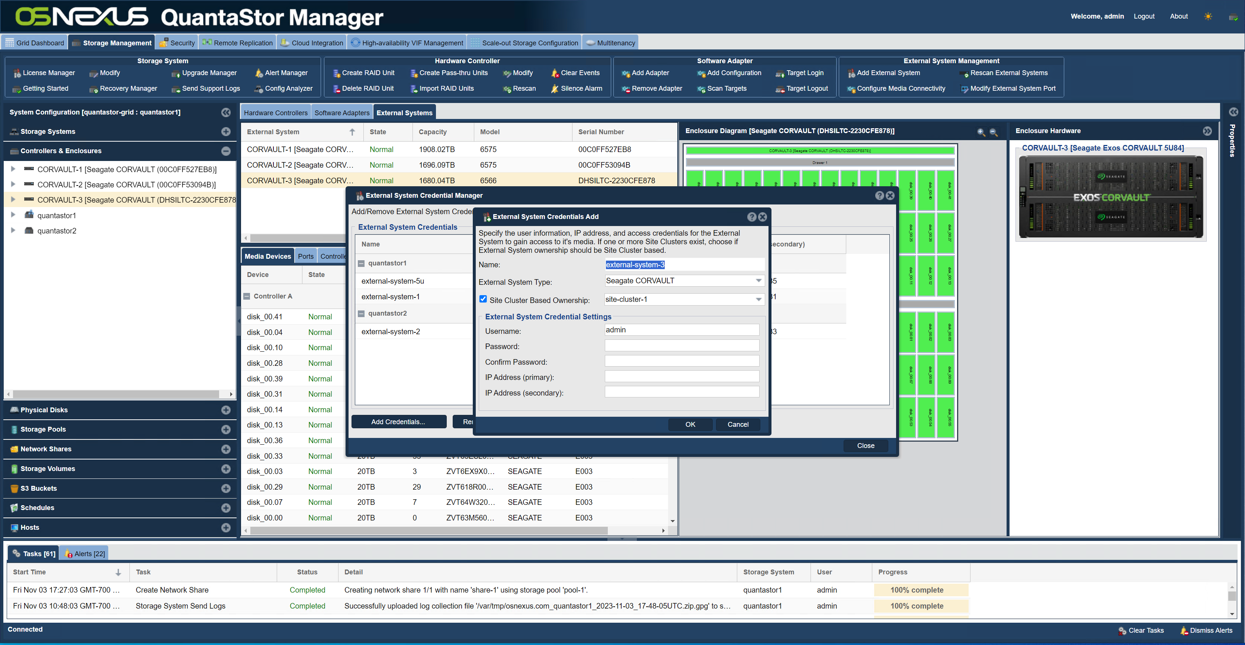
Seagate Integrated

Slide 9
Auto-Tiering to Seagate Lyve Cloud
NAS to Cloud Storage Gateway
Access cloud object storage via NFS & SMB
NAS to Cloud Storage Tiering
Auto-copy and tiering of files to the cloud
NAS to Cloud Backup Policies
Setup auto copy and move schedules for easy backup and migration to/from cloud and 3rd party NAS
Backup Policies
Auto Tiering
File Gateway

Slide 10
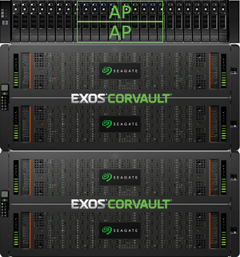
Scale-out Object Storage Overview
“STANDARD”
Storage-Class
HYBRID
EC + EC
OBJECT STORAGE ZONE
us-east-1
“PERFORMANCE”
Storage-Class
ALL-FLASH
REPLICA
Scale-out Object Storage
w/ Intelligent Auto-tiering

Slide 11
Intelligent Data-placement / Auto-tiering
Automatically classifies objects by name, size, tenant and other user definable rules for optimal placement
“STANDARD”
Storage-Class
HYBRID
EC + EC
OBJECT STORAGE ZONE
us-east-1
“PERFORMANCE”
Storage-Class
ALL-FLASH
REPLICA
Clients
Scale-out Object Storage
w/ Intelligent Auto-tiering

Slide 12
Eliminate Complex Data Migrations
Initial Deployment
Expansion
Expansion
Data rebalances across the cluster automatically
Expand by adding media and/or additional storage system with zero downtime
Shrink to phase-out old hardware and media with zero downtime
Use latest media, supports mixed media sizes and types
Use the latest servers, including certified models for major vendors
Dynamically recategorize data into different storage classes / tiers

Slide 13
Ultra-high Durability
Software Erasure Coding
HW Erasure Coding
HW Erasure Coding
HW Erasure Coding
HW Erasure Coding
HW Erasure Coding
HW Erasure Coding
HW Erasure Coding
HW Erasure Coding
HW Erasure Coding
HW Erasure Coding
Industry Leading Durability
Hardware Erasure Coding (Seagate ADAPT) provides 99.9999% durability
Software Erasure Coding (Ceph based) provides 99.9999% durability
Combined they provide 99.999999999999% (14 nines) of durability
Simplified Maintenance
Drive rebuilds are localized to the Seagate Corvault units, no network impact
Can handle multiple drive failures in every node simultaneously with no downtime

Slide 14
Multisite Zone & Bucket Replication
Replicate unidirectionally or bidirectionally between zones.
Objects are queued to replicate automatically between sites without delay.
Clusters/zones can asymmetrical with different hardware generations, EC layouts, media sizes, types, and different sized clusters.
OBJECT STORAGE ZONE
us-west-1
OBJECT STORAGE ZONE
us-east-1
OBJECT STORAGE ZONE
us-south-1

Slide 15
Data Security / Ransomware Protection
Strongest protection will come from using Compliance mode
Test retention policies using Governance mode first as it has overrides that can be used to administratively delete buckets
Compliance & Governance modes prevent deletion of objects for a set period of time
Ransomware attacks will leave ‘delete markers’ which can be easily removed.
Legal-Hold is a per-object policy that can be set as an additional protection on specific objects. This prevents explicit removal and removal by Compliance/Governance lifecycle policies.
legal-hold
D
Bucket
D
D
D
Bucket
D
D
D

Slide 16
QuantaStor + Seagate All-Flash Scale-up
All-Flash Performance
  ~250K IOPS per pool, ~500K IOPs per cluster
Use Cases
  VDI / Virtual Desktop Storage
  Server Virtualization Storage (VMware ESXi, HyperV, KVM)
  Databases / OLTP
Key Features
  iSCSI + NFS + SMB
  End-to-End Encryption
  KMIP Key Management
  MFA and 2FA
  Advanced Role-based Access Controls (RBAC)
  LDAP/Active Directory Integration w/ single-sign-on
  FIPS 140-2 L1 Certified
All-Flash Performance
NAS/SAN Cluster
250K IOPS
All-Flash Performance
NAS/SAN Cluster
500K IOPS
Notes:
Highly-available file & block storage solution
Supports all major protocols SMB, NFS & iSCSI
Easily expand with zero downtime
Advanced security features including RBAC, encryption-in-transit, encryption-at-rest, single-sign-on, NIST FIPS 140-2 certified
VMware and Veeam Ready certified
Automatic bit-rot detection & correction
Hybrid configuration includes triple-mirrored SSD to boost meta-data and small file performance

Slide 17
QuantaStor + Seagate Hybrid Scale-up
Hybrid Performance
  ~4GB/sec per pool, 8GB/sec per cluster
  Small file & Meta-data Offload to All-Flash Storage Tier
Common Use Cases
  Backup (Veeam, Commvault, Veritas, Rubric, etc)
  Archive / Data Warehousing / Logging
  CCTV / Streaming Video
  Media Editing, Media Asset Management
  User Home Directories
Key Features
  iSCSI + NFS + SMB
  Immutability / WORM Support
  Immutable Snapshots
Hybrid Performance
NAS/SAN Cluster
Hybrid Performance
NAS/SAN Cluster
Notes:
Highly-available file & block storage solution
Supports all major protocols SMB, NFS & iSCSI
Easily expand with zero downtime
Advanced security features including RBAC, encryption-in-transit, encryption-at-rest, single-sign-on, NIST FIPS 140-2 certified
VMware and Veeam Ready certified
Automatic bit-rot detection & correction
Hybrid configuration includes triple-mirrored SSD to boost meta-data and small file performance

Slide 18
QuantaStor + Seagate Hybrid Scale-out Solutions
Seagate + QuantaStor Scale-out
File, Block & Object
All-Flash Performance
    ~300MB/sec per SSD added to cluster (eg. 60GB/sec for 200x SSD cluster)
Hybrid Performance
    ~60MB/sec per HDD added to cluster (eg. 12GB/sec for 200x HDD cluster)
Use Cases
  Content Delivery Networks
  Media Archive / Media Asset Management
  PACS / DICOM Images
  AI/ML HPC Filesystem
1PB to 30PB
9PB to 100PB+
Notes:
Unified object, file, and block storage
Scalable to over 100PB per Storage Grid
Supports all major protocols S3, NFS, SMB, iSCSI
Native file protocol accessible (CephFS) for HPC use cases
Seagate CORVAULT Integrated
Reduces CPU and RAM requirements by 50%
Reduces drive maintenance costs by ~50%
Reduces software costs by 10%
Increases solution scalability by 300%
Ideal for rack-scale object & file >= 12PB

Slide 19
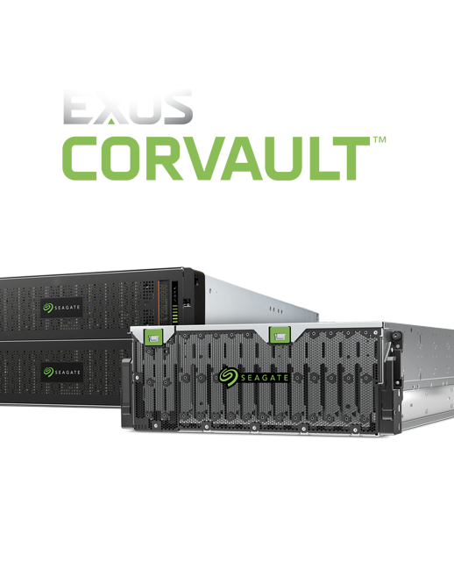
Seagate Corvault
Integration

Slide 20
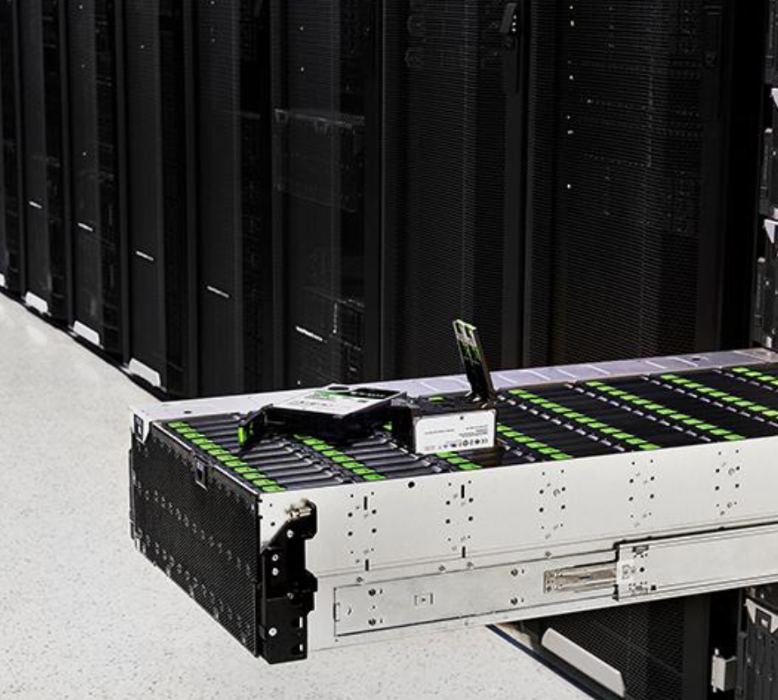
New Innovations, New Challenges
HAMR technology will deliver 30TB HDDs and beyond
Storage clusters are requiring increasing amounts of compute power
Replacing media is time consuming and labor intensive
Notes:
leads to longer rebuild times, reducing durability & performance
adding costs for CPU, RAM and energy requirements
increasing system TCO and maintenance costs

Slide 21
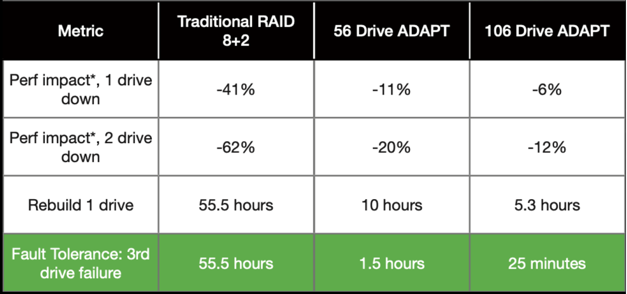
A New Generation of Storage Virtualization
To solve the rebuild time issue, we need smart JBODs with fast auto-healing via advanced erasure-coding technology
ADAPT 16+2
Erasure Coding
Systems return to full health 95% faster than traditional RAID and with minimal performance impact.

Slide 22
A New Generation of Storage Virtualization
To reduce maintenance costs, we need the system to be able to repair bad media automatically.
Seagate Advanced Drive Regeneration (ADR) technology recovers ~15% of failed media and puts it back into service within the ADAPT pool automatically, that’s one less trip to the datacenter & good for the environment.
ADAPT 16+2
Erasure Coding
ADR
ADR

Slide 23

A New Generation of Storage Virtualization
To achieve scale-out hyper-scalability from 1PB to 300PB+ we first need to reduce the physical device count through storage virtualization.
3:1 block device reduction via logical volumes results in a 2:1 reduction in CPU and RAM requirements, that’s green storage.
VOLUME
VOLUME
VOLUME
VOLUME
VOLUME
VOLUME
ADAPT 16+2
Erasure Coding
VOLUME
VOLUME
VOLUME
VOLUME
VOLUME
VOLUME
VOLUME
VOLUME
VOLUME
VOLUME
VOLUME
VOLUME

Slide 24
Q&A
Resources & Quote Requests
  Scale-out Solution Designer
    https://link.osnexus.com/stx-scale-out
  Scale-up Solution Designer
    https://link.osnexus.com/stx-scale-up
  More Information
    info@osnexus.com
    https://www.seagate.com/solutions/osnexus/
    https://www.osnexus.com

