Slide 1
Supermicro + QuantaStor
Software Defined Storage Solutions
2024

Slide 2
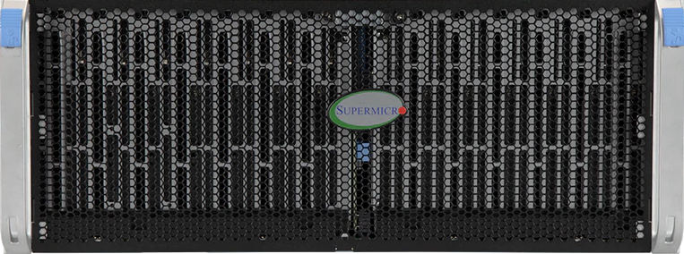
Storage Grid Technology
Storage Grid technology unifies management of QuantaStor servers and clusters across racks, sites, and clouds.
Unified File, Block & Object
All major storage protocols are supported including NFS/SMB, iSCSI/FC, and S3.
Secure
Advanced RBAC, end-to-end encryption support, and compliance with NIST 800-53, 800-171, HIPAA, CJIS, & FIPS 140-2 L1 certified.
NAS
SAN
S3
What is QuantaStor?
FILE
BLOCK
OBJECT
Enterprise Software Defined Storage Platform
Scale-up & Scale-out
Integrated with enterprise-grade open storage technologies (Ceph & ZFS).
Hardware Flexibility
QuantaStor supports and is integrated with the full line of Supermicro servers, JBODs, and SBB clustered storage solutions.

Slide 3
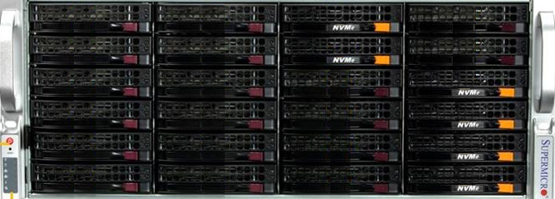
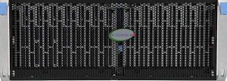
Scale-up
&
Scale-out
New 2U dual-node HA NVMe system (SSG-221E-DN2R24R) to be the primary building block for all scale-up solutions.
125GB/sec
10GB/sec
8GB/sec
28GB/sec
ALL-FLASH
SAN+NAS
HYBRID SAN+NAS
9GB/sec
NAS
SAN
HYBRID OPTIMIZED
FILE+OBJECT
DENSITY OPTIMIZED FILE+OBJECT
HPC, AI/ML, K8N
FILE
BLOCK
NAS
SAN
S3
FILE
BLOCK
OBJECT

Slide 4
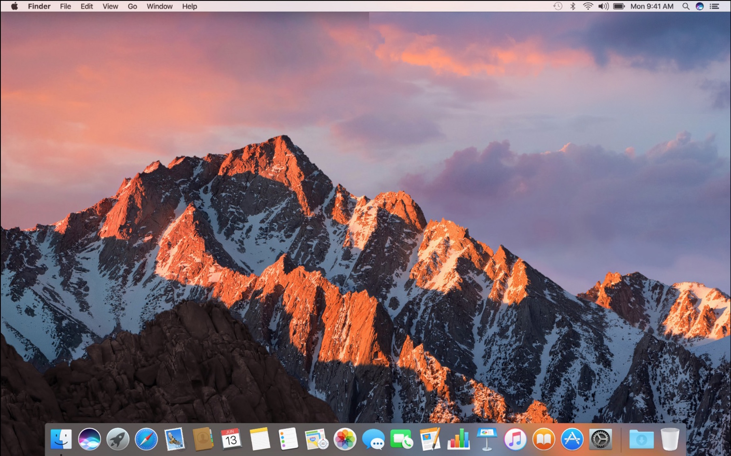
Scale-up Storage Solutions
Scale-up Storage Architecture
C1
C2
FILE
When a user writes file to scale-up storage it’s to one of two servers that act as “controllers”.
D1
D2
D3
D4
P1
P2
Data is mirrored or striped across external disk enclosures (JBODs) using RAID technology. External disk enclosures are typically much lower cost than servers.
D1
D2
D3
D4
P1
P2
Data is highly-available with zero downtime even in the event of a server failure or a disk enclosure failure.
NAS
SAN
FILE
BLOCK

Slide 5
Scale-out Storage Solutions
Scale-out Storage Architecture
M2
FILE
K1
FILE
FILE
K2
FILE
Data is fragmented and protected using “erasure coding” to ensure availability of data even if there’s a server failure.
K3
FILE
K4
Data is highly-available with zero downtime even in the event of multiple server failures due to the architecture and “coding blocks” shown as M1 and M2 in the diagram.
FILE
M1
All nodes of the cluster are active-active for all protocols. S3, NFS, SMB, iSCSI, FC, plus native CephRBD, CephFS options for best performance.
NAS
SAN
S3
FILE
BLOCK
OBJECT

Slide 6
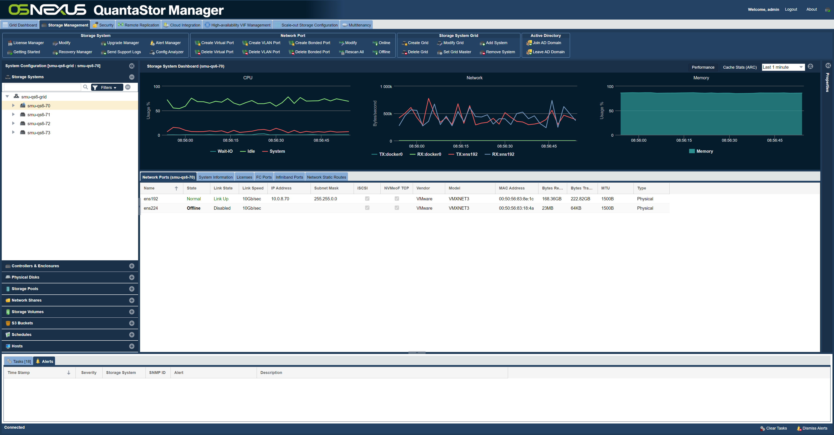
One Platform, Unified Management
QUANTASTOR STORAGE GRID
S3/SAN/NAS
S3/SAN/NAS
SAN/NAS
SAN/NAS
S3/SAN/NAS
SAN/NAS
SAN/NAS
Seattle Datacenter
Dallas Datacenter
London Datacenter
Tokyo Datacenter
Grid technology simplifies security enforcement, storage management while enabling organizations to scale without bounds.

Slide 7
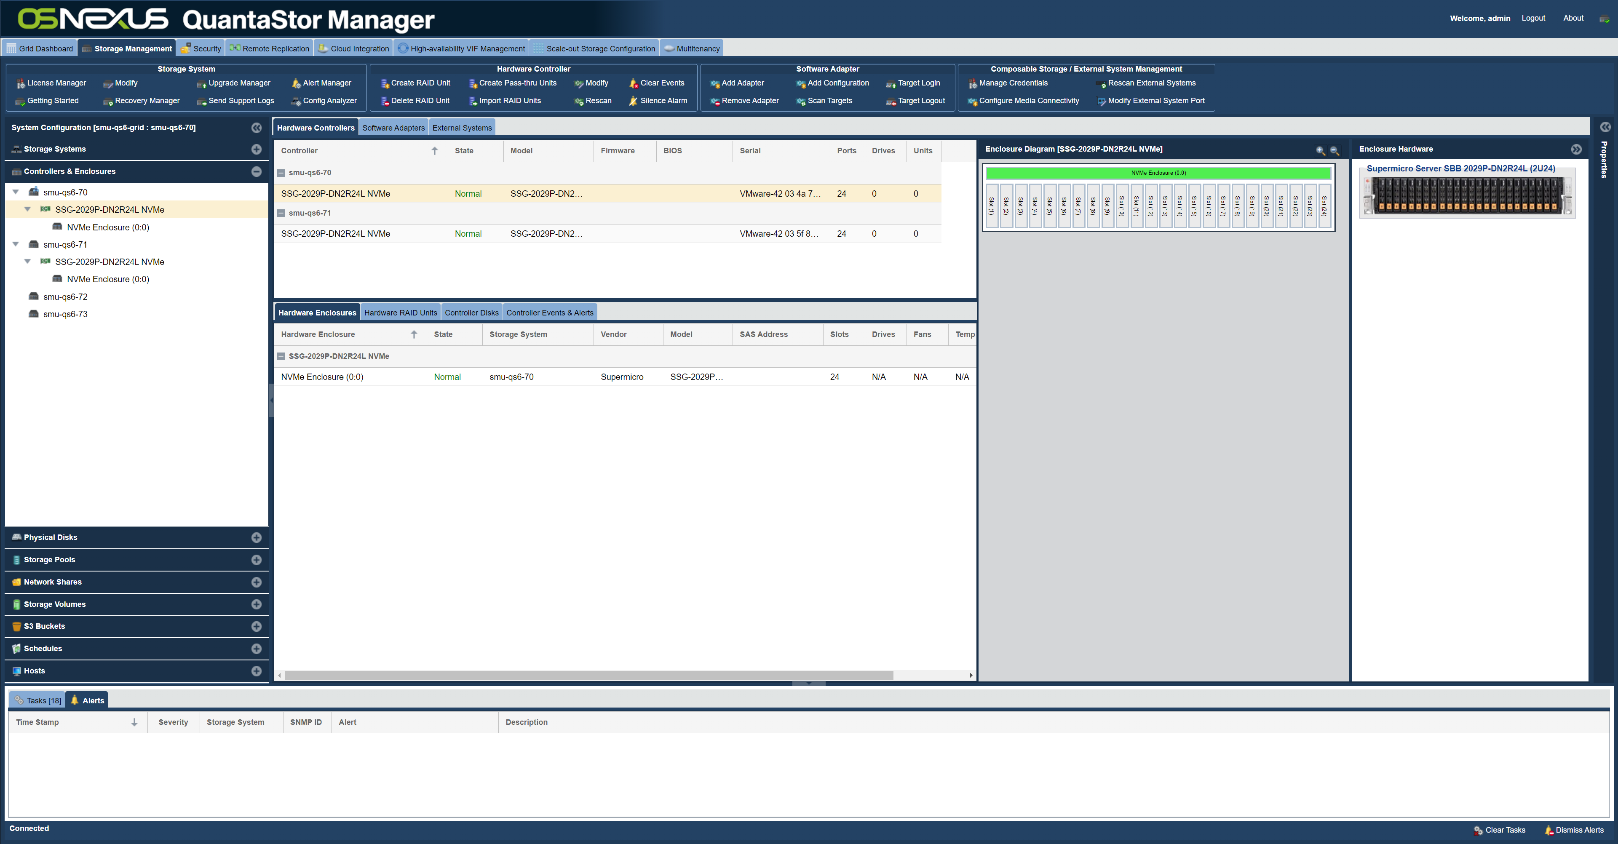
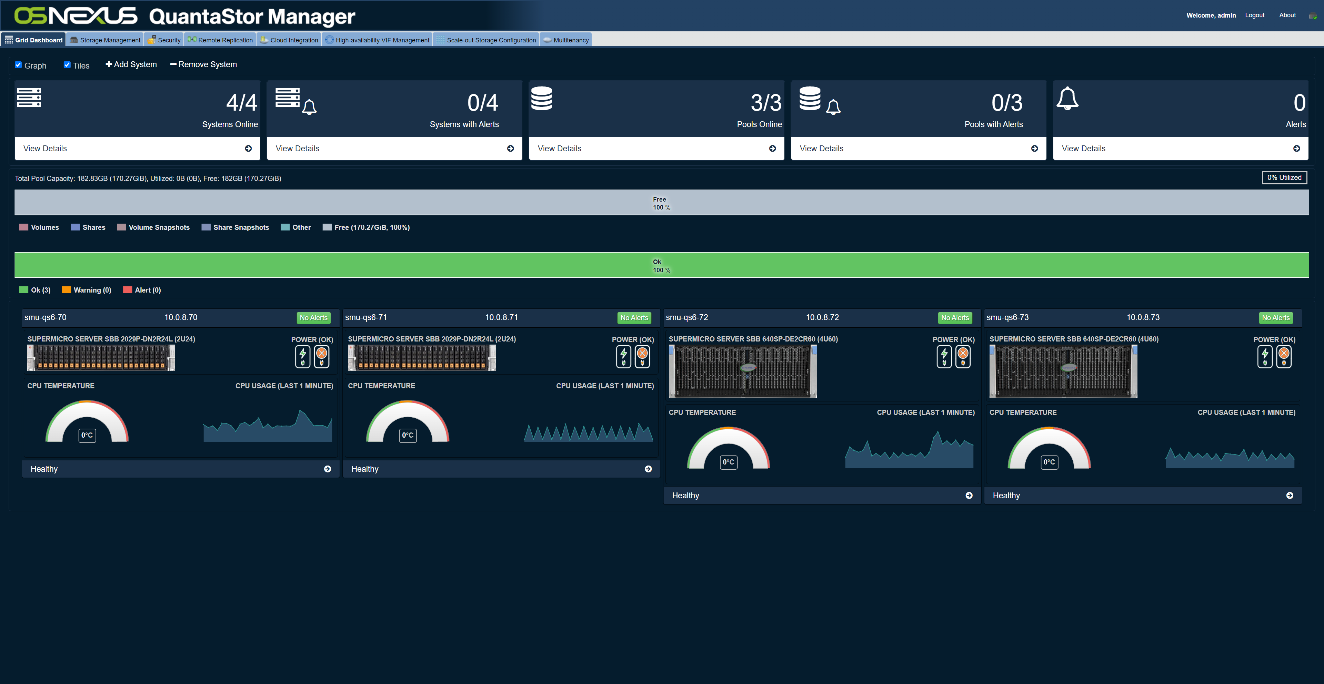
One Platform, Unified Management
Unified storage platform with advanced grid technology, security features, and industry leading hardware integration.

Slide 8
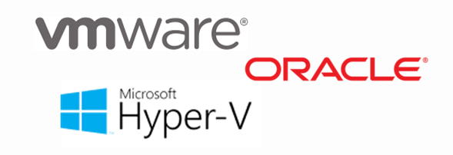
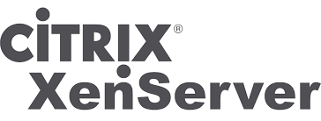
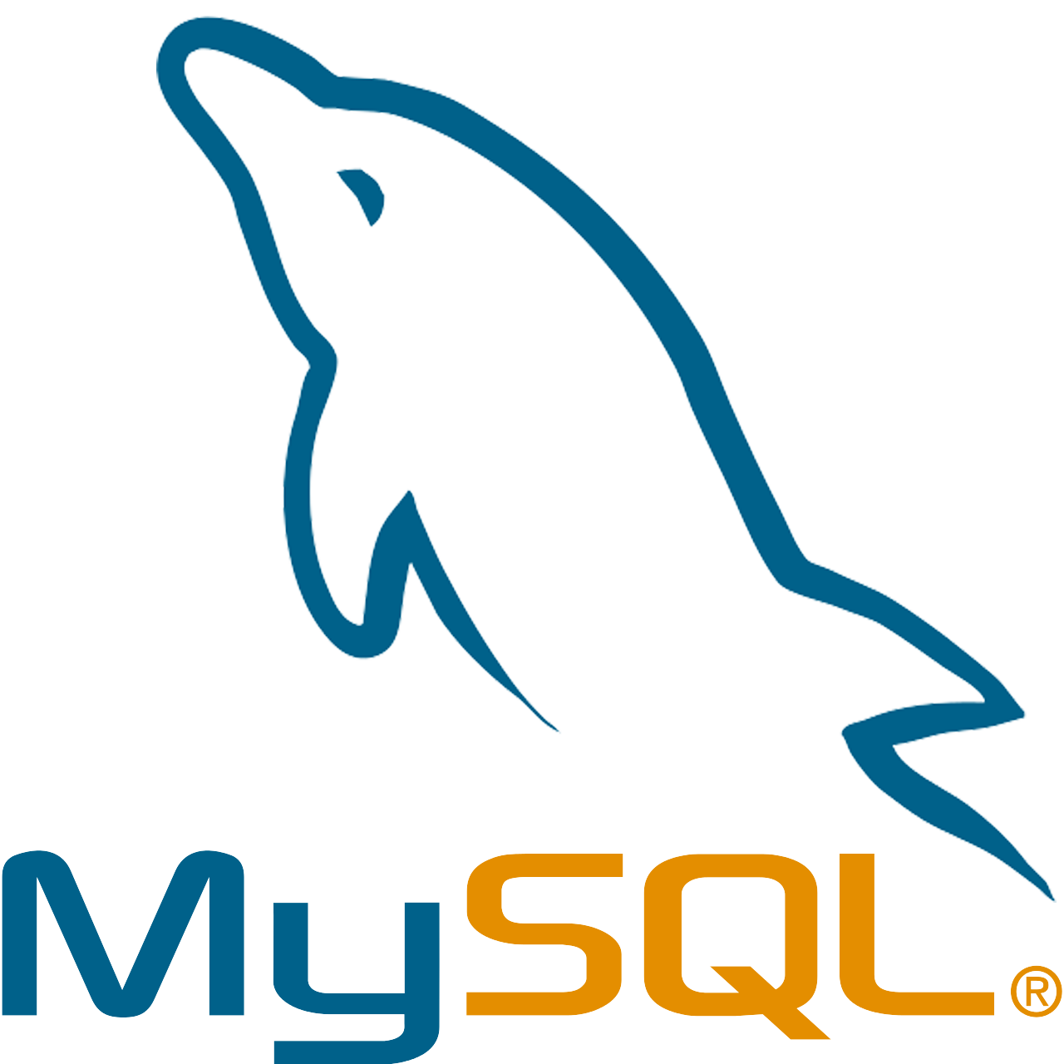
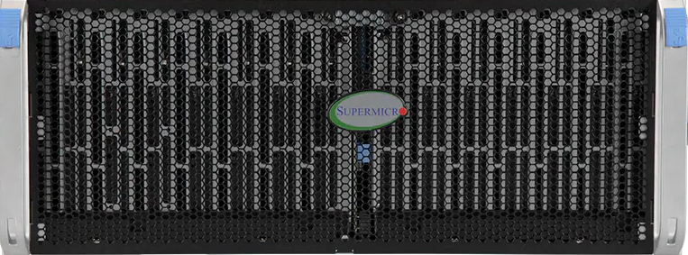
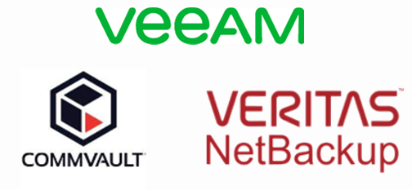
Designing Scale-up Solutions
Common Use Cases
Unified File & Block Storage (iSCSI/FC/SMB/NFS)
Scale-up to over 10PB per cluster (6x JBODs w/ 540 devices)
All-Flash Performance ~= 300K IOPS per Pool, 6GB/sec per Pool
Hybrid Performance ~= 4GB/sec Throughput per Pool
Compact & cost efficient
High Performance
SAN/NAS Cluster
Common Use Cases
High Capacity
SAN/NAS Cluster

Slide 9
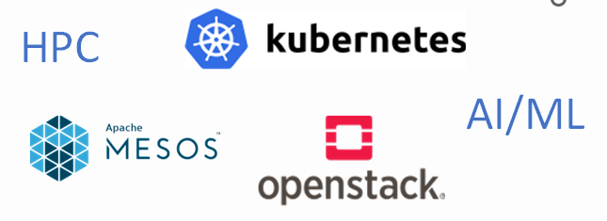
Designing Scale-out Solutions
Unified object, file, and block storage
Deploy multiple clusters per Storage Grid
Scalable to over 100PB per Storage Grid
Supports all major protocols S3, NFS, SMB, iSCSI, and FC
Native file protocol for HPC use cases
All-flash Performance (+300MB/sec per SSD/NVMe)
Hybrid Performance (+60MB/sec per HDD)
Common Use Cases
Scale-out File, Block & Object

Slide 10
Intelligent Data-placement / Auto-tiering
Automatically classifies objects by name, size, tenant and other user definable rules for optimal placement
OBJECT STORAGE ZONE
us-east-1
“STANDARD”
Storage-Class
HYBRID
EC + EC
Clients
“PERFORMANCE”
Storage-Class
ALL-FLASH
REPLICA
Scale-out Object Storage w/ Intelligent Auto-tiering

Slide 11
Eliminate Complex Data Migrations
Initial Deployment
Expansion
Expansion
Data rebalances across the cluster automatically
Expand by adding media and/or additional storage system with zero downtime
Shrink to phase-out old hardware and media with zero downtime
Use latest media, supports mixed media sizes and types
Use the latest servers, including certified models for major vendors
Dynamically recategorize data into different storage classes / tiers

Slide 12
Data Security / Ransomware Protection
Strongest protection will come from using Compliance mode
Test retention policies using Governance mode first as it has overrides that can be used to administratively delete buckets
Compliance & Governance modes prevent deletion of objects for a set period of time
Ransomware attacks will leave ‘delete markers’ which can be easily removed.
Legal-Hold is a per-object policy that can be set as an additional protection on specific objects. This prevents explicit removal and removal by Compliance/Governance lifecycle policies.
legal-hold
D
Bucket
D
D
D
Bucket
D
D
D

Slide 13
Multisite Zone & Bucket Replication
OBJECT STORAGE ZONE
us-east-1
Replicate unidirectionally or bidirectionally between zones.
Objects are queued to replicate automatically between sites without delay.
Clusters/zones can asymmetrical with different hardware generations, EC layouts, media sizes, types, and different sized clusters.
OBJECT STORAGE ZONE
us-west-1
OBJECT STORAGE ZONE
us-south-1

Slide 14
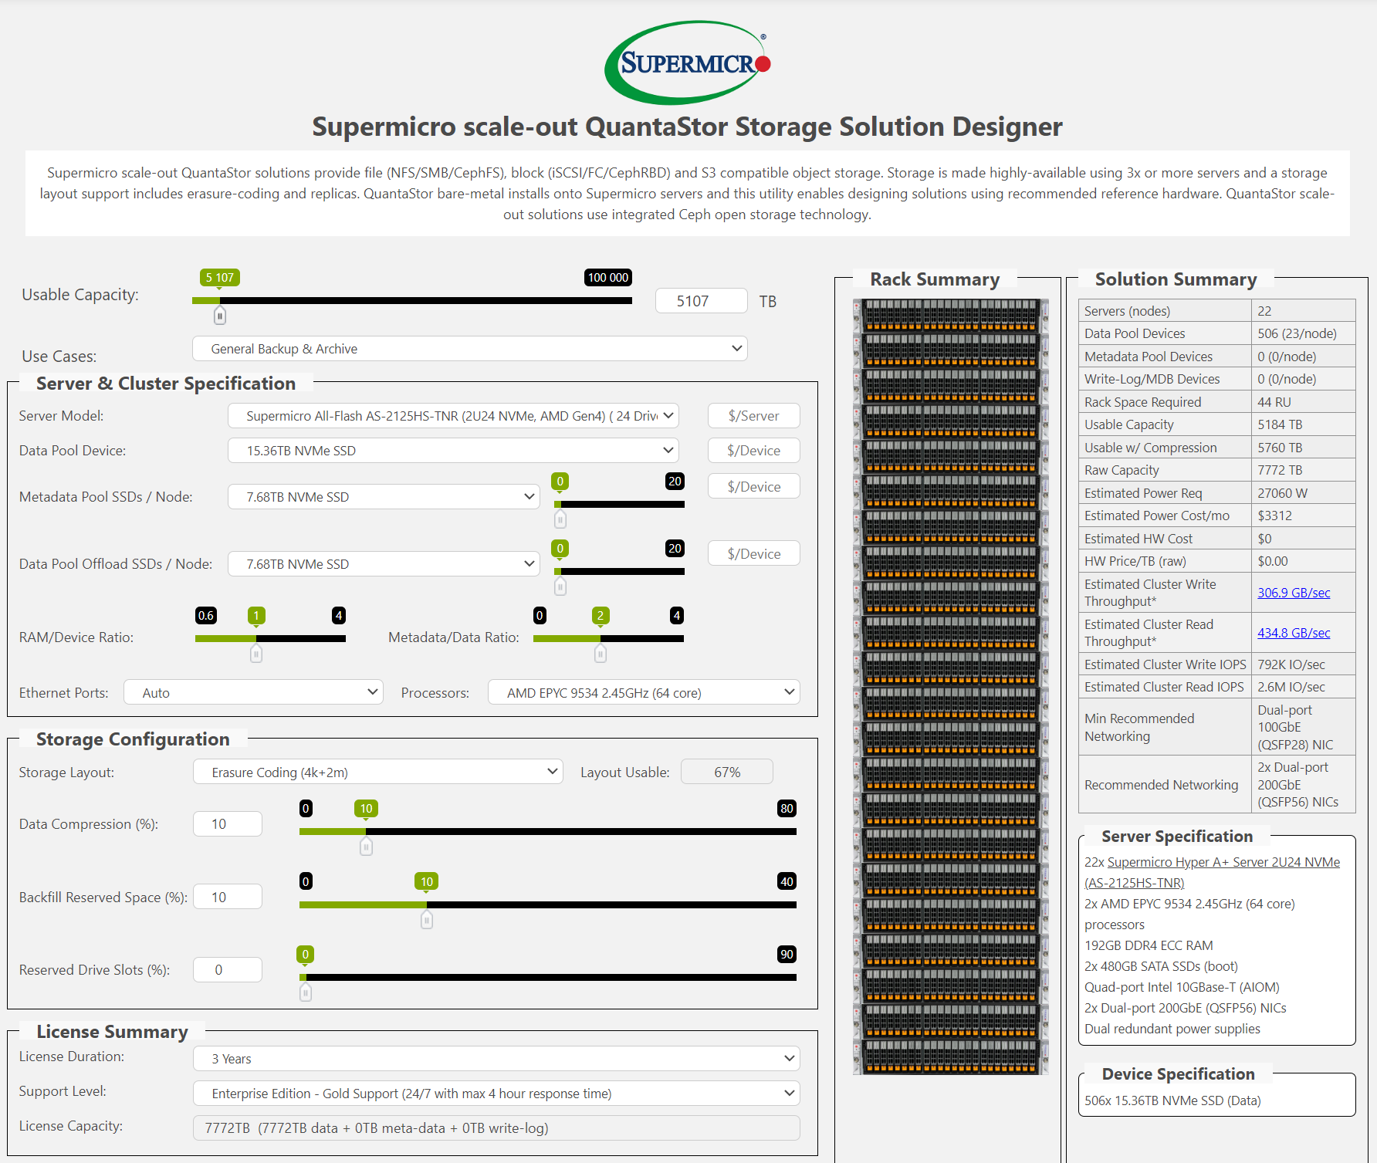
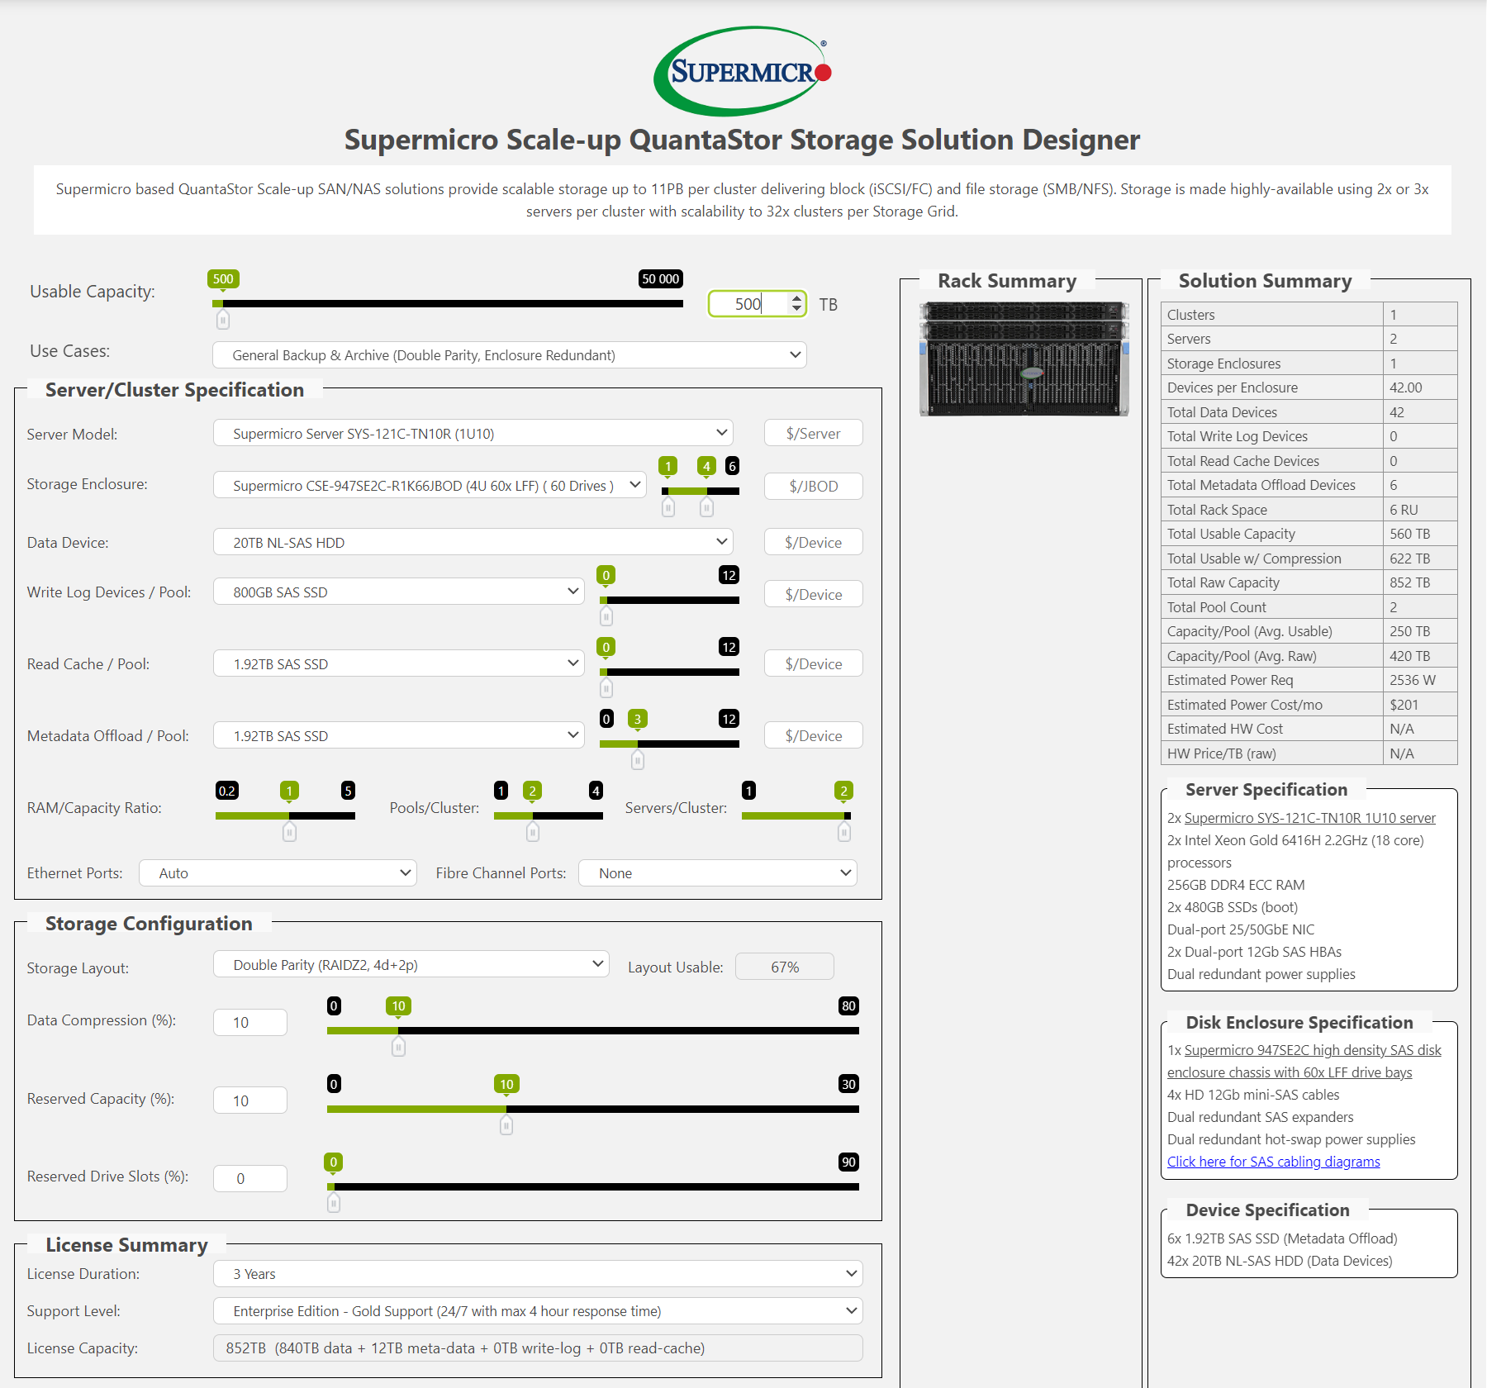
Designing Storage Solutions
https://link.osnexus.com/smc-scale-out
https://link.osnexus.com/smc-scale-up

Slide 15
Maintenance Made Easy
Zero-touch maintenance
Auto-heals after replacing media, no further action required.
Single-pane-of-glass management, accessible from all systems
No extra software to install, it’s all built in.
Automated self diagnostics, health reporting & email alerting
Easy setup & deployment
Configure in less than an hour after rack & stack.
24/7 support is comprehensive, global support team comprised of all tier-3 experts
Support covers complete stack, root cause analysis with one support call.
Scale from 100TB to over 100PB
Pricing continually decreases as you expand.
End-to-end encryption with automated snapshots to protect against ransomware

Slide 16
Contact info:
www.osnexus.com
info@osnexus.com

